Slide 1

Introduction To Html
Image By Lukas
https://www.pexels.com/@goumbik

Slide 2
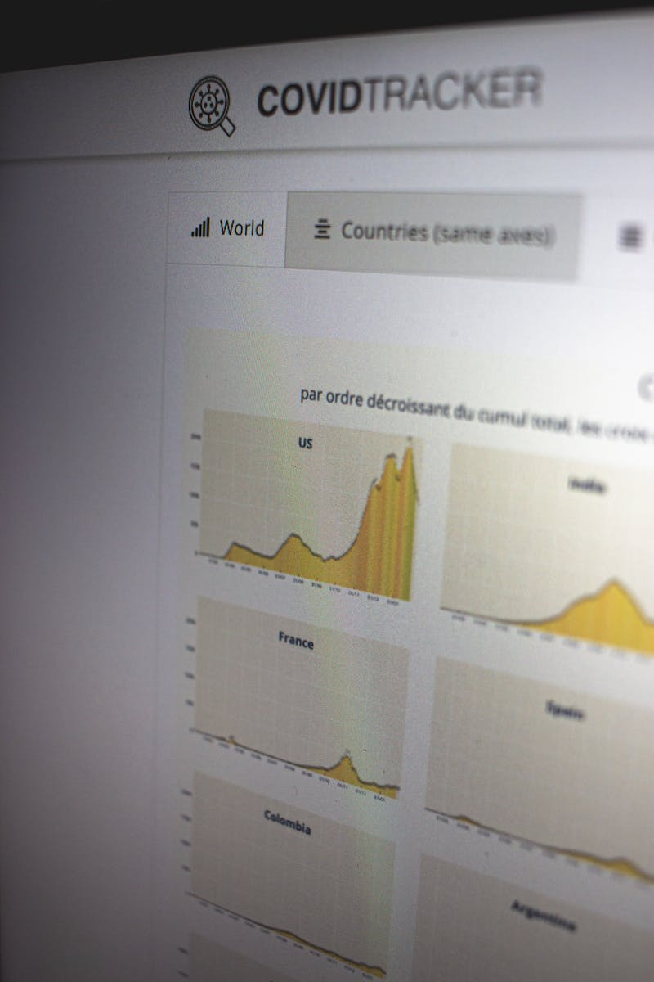
What is HTML?
HTML (Hypertext Markup Language) is the standard markup language used to create web pages. It defines the structure and layout of a webpage by using various elements and tags. HTML code can be viewed in a web browser and is the backbone of every web page.
Image By Mathias Reding
https://www.pexels.com/@matreding

Slide 3
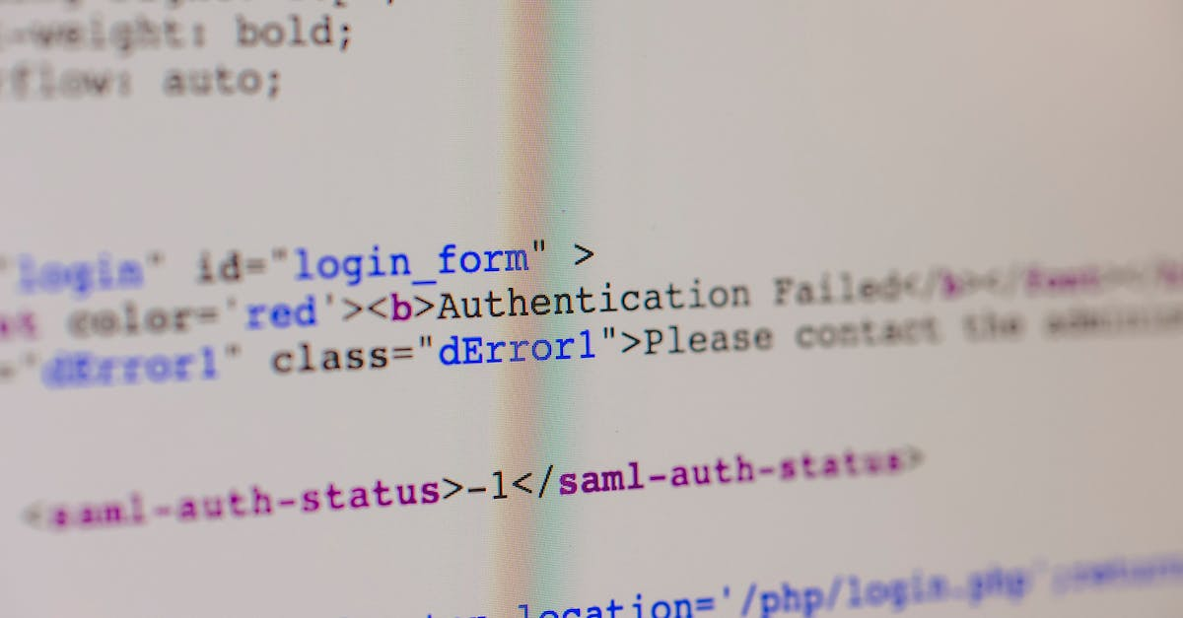
HTML Structure
HTML documents consist of several elements, such as the <html>, <head>, and <body> tags. The <html> tag represents the root of an HTML document, while the <head> tag contains metadata about the document. The <body> tag holds the visible content of the webpage. By incorporating these elements correctly, you can create a well-structured HTML document.
Image By Markus Spiske
https://www.pexels.com/@markusspiske

Slide 4
What is a tag?
Tags surround the content to be formatted. There must be a closing tag (using a /) for every opening tag.
For example
<p>This is a paragraph</p>
<p>This is another paragraph</p>
Image By Markus Spiske
https://www.pexels.com/@markusspiske

Slide 5
Tags and attributes
Attributes add additional information to tags.
Their format is attributename=”attributevalue”
For example:
<p background-colour=”red”>This is a paragraph which will be red</p>
<p>This is another paragraph</p>
Image By Markus Spiske
https://www.pexels.com/@markusspiske

Slide 6

Headings and Paragraphs
HTML offers six levels of headings, from <h1> to <h6>, each representing different levels of importance. Headings help structure your content and assist with search engine optimization. Paragraphs, denoted by the <p> tag, allow you to write and structure text within your web pages.
Example:
<body>
<h1>Main Heading (Level 1)</h1>
<p>This is the main content of the page.</p>
<h2>Subheading (Level 2)</h2>
<p>Additional text for the subheading.</p>
<h3>Sub-subheading (Level 3)</h3>
<p>More text for the sub-subheading.</p>
</body>
Image By Lukas
https://www.pexels.com/@goumbik

Slide 7

Hyperlinks and Anchors
Hyperlinks, created with the <a> tag, enable you to link web pages, documents, or specific parts of a webpage together. By using anchors, identified through the <a> tag together with the href attribute, users can easily navigate within a webpage. Understanding how to create and utilize hyperlinks is crucial for effective webpage navigation.
Example:
<a href="page1.html">Link to Page 1</a>
Image By Alexander Ant
https://www.pexels.com/@alexant

Slide 8

Lists and Formatting
HTML provides ordered lists (<ol>), unordered lists (<ul>), and definition lists (<dl>), which allow you to present information in a structured format. Lists can be further customized using CSS and various formatting options, including indentation and numbering styles. Proper use of lists enhances the readability and organization of your content.
Example:
<ul>
<li><a href="page1.html">Link to Page 1</a></li>
<li><a href="page2.html">Link to Page 2</a></li>
</ul>
Image By Dominika Roseclay
https://www.pexels.com/@punchbrandstock

Slide 9
Images and Multimedia
Incorporating images, videos, and audio files into web pages broadens their appeal and enhances engagement. By using the <img> tag and the src attribute, you can embed images, while the <video> and <audio> tags facilitate the inclusion of videos and audio files. Understanding how to correctly insert and format media content is essential for effective web design.
Example:
<h1>Beautiful Sunset</h1>
<img src="sunset.jpg" alt="A beautiful sunset">

Slide 10

Forms
Forms, created using the <form> tag, enable users to input data and interact with webpages. The proper use of tables and forms is essential for user interaction and data presentation.
Example:
<form>
<label for="name">Name:</label>
<input type="text" id="name" name="name">
<br>
<label for="email">Email:</label>
<input type="email" id="email" name="email">
<br>
<input type="submit" value="Submit">
</form>
Image By Polina Tankilevitch
https://www.pexels.com/@polina-tankilevitch

Slide 11
Example:
<table border="1">
<tr>
<th>Name</th>
<th>Age</th>
<th>Grade</th>
</tr>
<tr>
<td>John</td>
<td>20</td>
<td>A</td>
</tr>
<tr>
<td>Maria</td>
<td>22</td>
<td>B</td>
</tr>
</table>
Tables
Tables provide a way to display and organize data in a structured manner. HTML tables, constructed with the <table>, <tr>, <th>, and <td> tags, offer flexibility in terms of rows, columns, and formatting options.
Image By Polina Tankilevitch
https://www.pexels.com/@polina-tankilevitch

Slide 12

Semantic HTML
Semantic HTML tags convey meaning beyond just visual presentation. Tags such as <header>, <nav>, <section>, <article>, and <footer> provide a semantic structure to your webpage, enhancing accessibility, search engine optimization, and overall document structure. Utilizing semantic HTML helps improve both user experience and code readability.
Image By cottonbro studio
https://www.pexels.com/@cottonbro

Slide 13
CSS and HTML Integration
Cascading Style Sheets (CSS) allow you to control the visual appearance of HTML elements. Styles can be defined in the head section of an HTML document or a separate file which allows for more consistent styling. Elements, classes or ids can be targetted by a style.
Example:
<style>
body {
font-family: 'Arial', sans-serif;
background-color: #f2f2f2;
margin: 20px;
}
h1 {
color: #0077cc;
}
</style>
Image By Pixabay
https://www.pexels.com/@pixabay

Slide 14

Web Standards and Accessibility
Adhering to web standards and ensuring accessibility is essential for creating inclusive and universally accessible web pages. Compliance with web standards improves cross-browser compatibility and ensures that your web content is functional on different devices. Additionally, incorporating accessibility features, such as alt text for images and proper semantic structure, enables individuals with disabilities to access and interact with your website effectively.
Image By Masood Aslami
https://www.pexels.com/@masoodaslami

Slide 15

Thank You
Image By cottonbro studio
https://www.pexels.com/@cottonbro

